Slide 1
GPU-accelerated processing on CropDiversity
Fraser Macfarlane - Computer Vision RSE
Information and Computational Sciences

Slide 2

Deep Learning in a Nutshell
“Magic”
Training Data
Loss Function
Backpropagation and Gradient Descent

Slide 3
CPUs and GPUs
Central Processing Units (CPUs)
10s of computing cores
Low latency
Good for serial processing
Processes tasks that requires interactivity or interruption
Traditional programs are written predominantly to exploit CPU resources
Graphical Processing Units (GPUs)
1,000s or even 10,000s of computing cores
High Throughput
Good for parallel processing
Breaks tasks into subtasks that can be processed simultaneously/independently
Requires additional interpretation to convert traditional code into GPU readable instructions

Slide 4
Increasing Computation
CPUs tend to follow Moore’s Law
Number of transistors on a chip doubles every two years
Transistors – little electronic switches
Rapidly approaching the limits of current silicon technology
Becoming physically impossible to squeeze more transistors on a silicon wafer
The so called death of Moore’s Law
Why we see “3.6GHz” and “5.0GHz” boosted advertised on new Laptops
“Overclocking” - throwing more current at the problem for faster speeds

Slide 5
Why do we use GPUs?
Both CPUs and GPUs work in fundamentally different ways:
A CPU handles the majority of the processing tasks for a computer.
fast and versatile
built to handle any number of required tasks
accessing hard drive storage
logging inputs
moving data from cache to memory
That means that CPUs can bounce between multiple tasks quickly to support the more generalized operations of a workstation or even a supercomputer.
A GPU is designed from the ground up to render high-resolution images and graphics almost exclusively
GPUs focus on parallel processing
This doesn’t require a lot of context switching
identical computations used to create lighting/shading effects for can be continuously performed
Or, we could use them for convolutions…
Notes:
This parallelisation is different to SLURM parallelisation from yesterday
How many operations we can get through a specific set of resources at any one time

Slide 6

Why do we use GPUs - Example

Slide 7

CPU vs GPU – Chip Level
CPU – 16C (32T)
GPU – >1000C

Slide 8
CPU vs GPU – Core/Thread Level
CPU
GPU
Control
ALU
ALU
ALU
ALU
Cache
Memory (DRAM)
Memory (VRAM)
CPUs have to allocate more physical space on a chip to memory caches and controllers
This is what allows for such low latency
But limits the ability to do lots of simultaneous tasks

Slide 9
Speed Increases from Parallelisation
T4
Processing
GPU
(High Throughput)
T3
Idle
T2
Ready
T1
CPU
(Low Latency)
T1
T2
T3
T4
Time, ns

Slide 10
Speed Increases from Parallelisation
Linear functions
Computationally Intensive but parallelisable functions
…
Linear functions

Slide 11
Speed Increases from Parallelisation

Slide 12

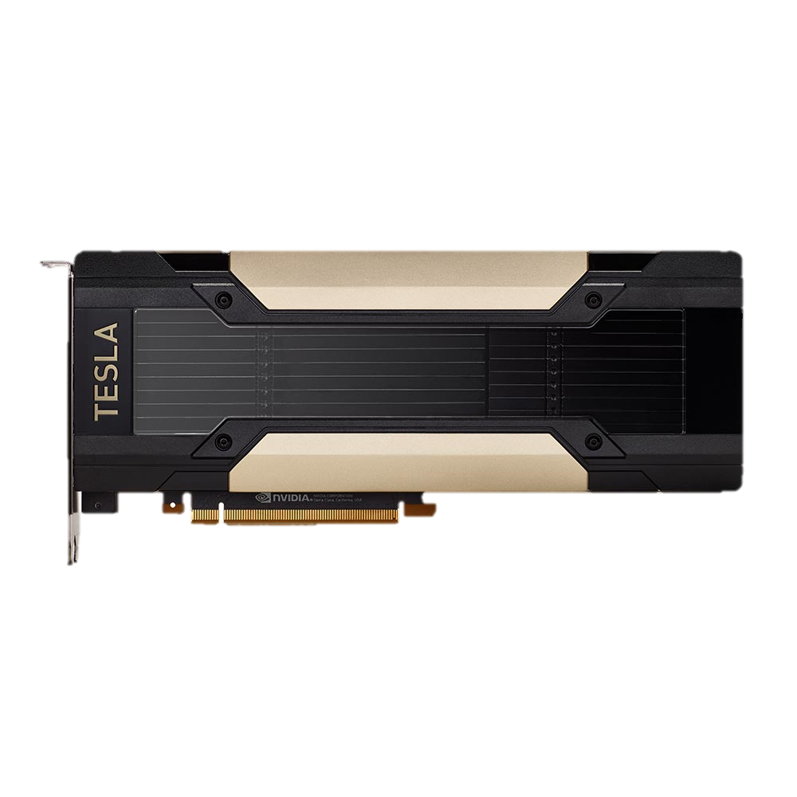


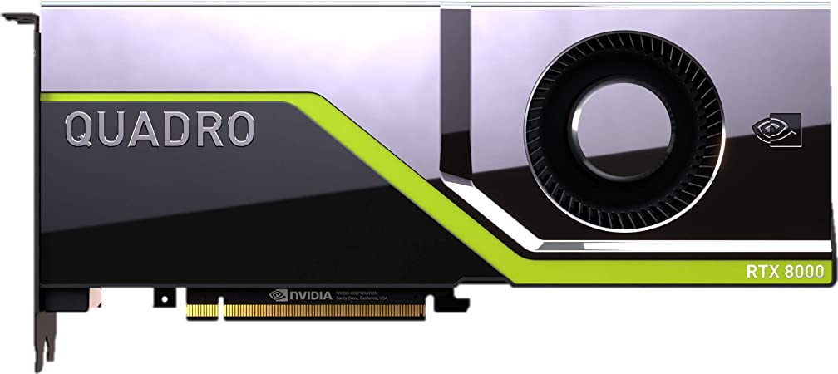
GPU Resources on Gruffalo
jaws
1 x NVIDIA Tesla V100 (16GB)
5,120/640 CUDA/Tensor Cores
thanos
2 x NVIDIA Tesla V100 (32GB)
10,240/1280 CUDA/Tensor Cores
twiki
2 x NVIDIA Quadro RTX 8000 (48GB)
9216/1152/144 CUDA/Tensor/RT Cores

Slide 13
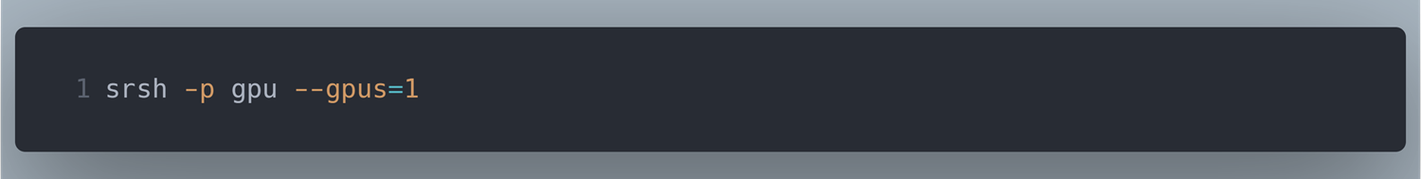
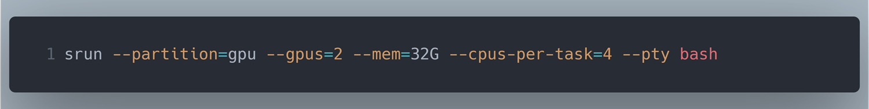
Requesting GPUs from SLURM
Interactive jobs:
Can also write bash scripts with specific #SBATCH commands

Slide 14
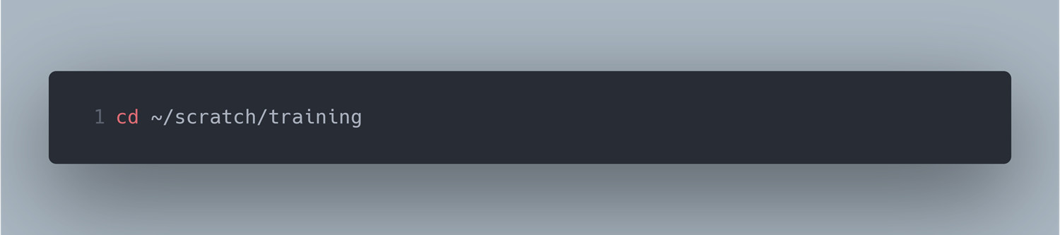
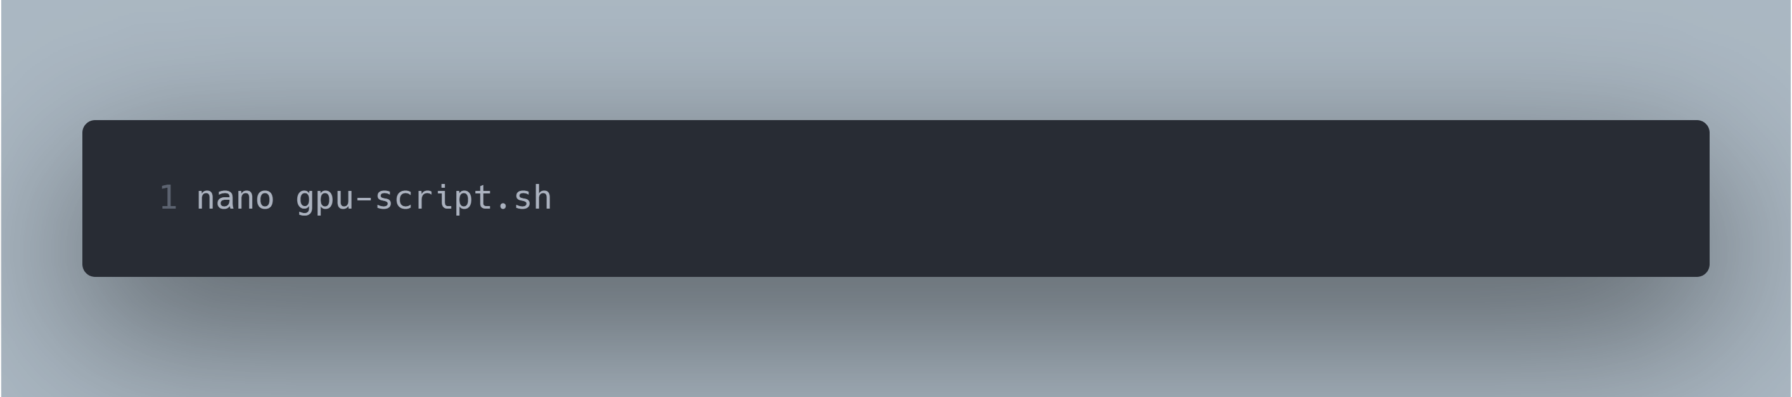
Quick Practical Exercise
cd into your training folder from yesterday:
Create a new shell script called gpu-script.sh:

Slide 15
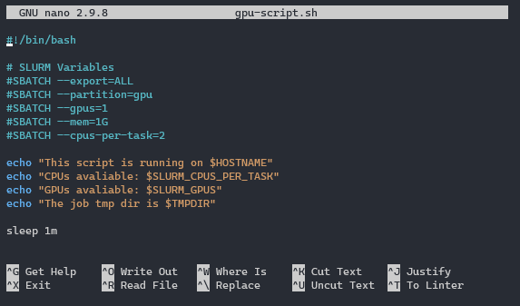
Quick Practical Exercise
Edit its contents to match the following:
Submit the script to slurm using: sbatch gpu-script.sh

Slide 16
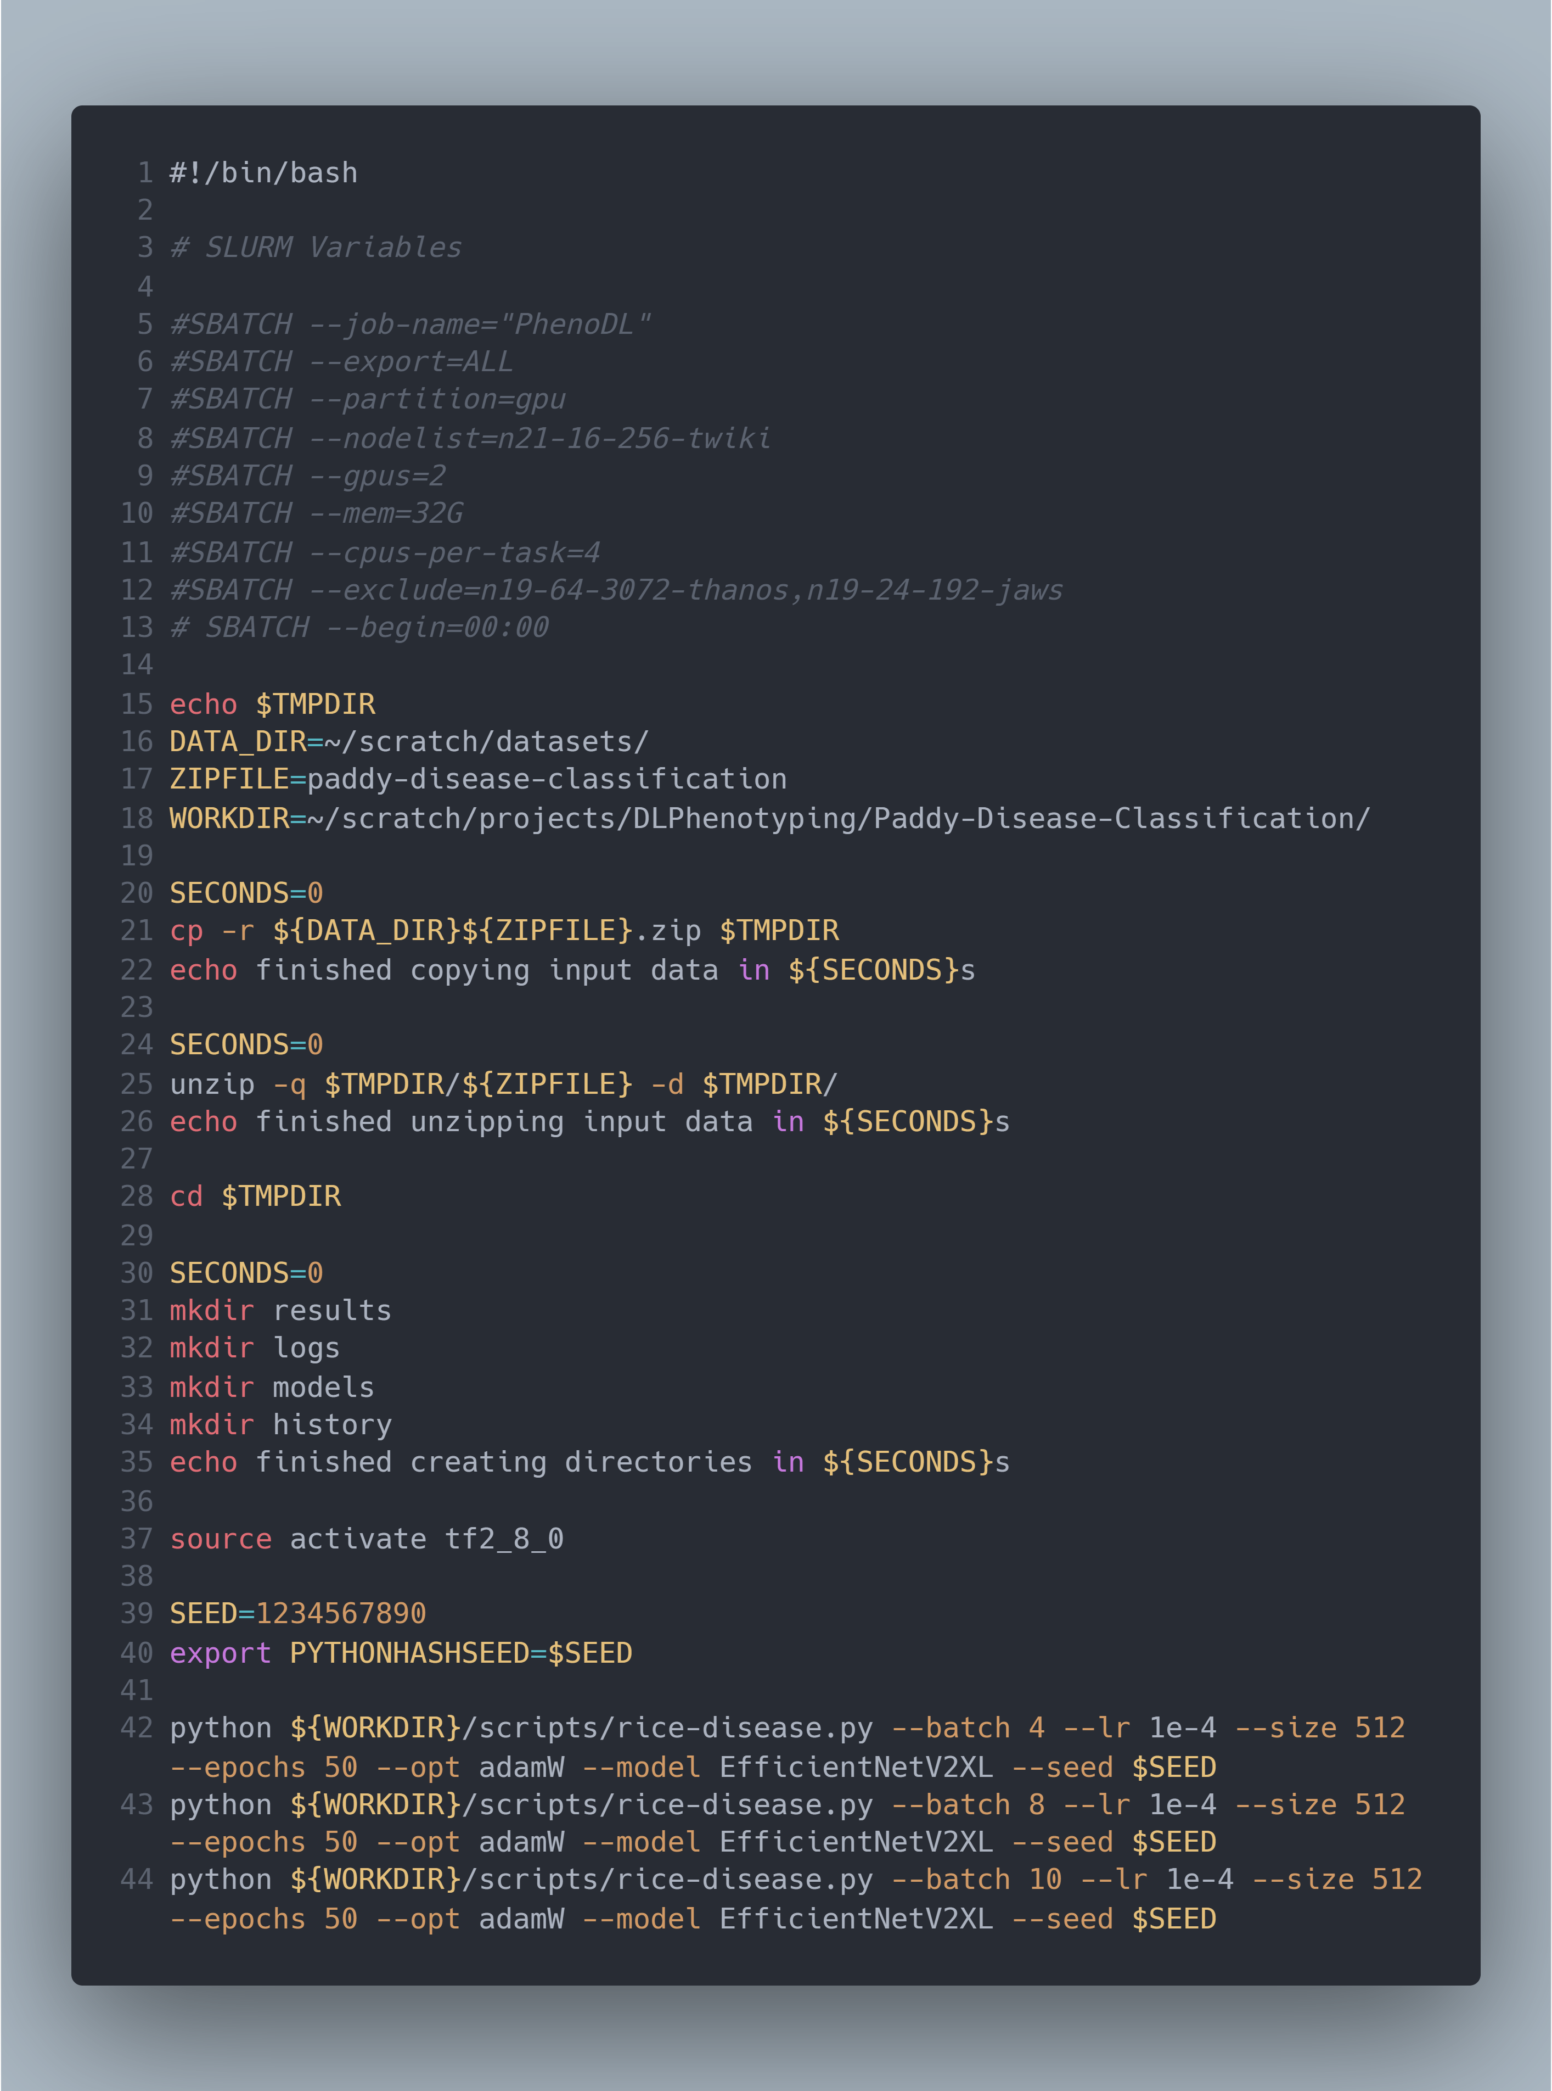
Example SLURM job file
Notes:
207,628,642 parameter model

Slide 17
SLURM Parameters
#SBATCH --job-name="PhenoDL"
#SBATCH --export=ALL
#SBATCH --partition=gpu
#SBATCH --nodelist=n21-16-256-twiki
#SBATCH --gpus=2
#SBATCH --mem=32G
#SBATCH --cpus-per-task=4
#SBATCH --exclude=n19-64-3072-thanos,n19-24-192-jaws
#SBATCH --begin=00:00
Notes:
Job name – obvious
Export – any environment variables from the submission environment and taken into the launched application
Partition – Specifies which partition to use – here it is GPU and the others are short, medium, long and himem
Nodelist – specifies the node(s) to use for the job – full node name required not just the shortform name
Gpus – specific to the gpu partition, number of gpus to request
Mem – amount of memory to request per node
Cpus - number of CPUs to request per node
Exclude – opposite of nodelist - do not load these nodes
Begin – specify a clock time to wait for before commencing the job – puts in a paused state so others can request resources out from under you

Slide 18
Example SLURM job file

Slide 19
Bash Syntax
echo – prints a variable to the terminal
$TMPDIR – Temporary directory created for each slurm job
/tmp/<USERNAME>_<SLURM_JOB_ID>
DELETED UPON JOB COMPLETION/TERMINATION
Note that any variables previously defined, i.e., SECONDS, are referenced using a dollar sign - ${SECONDS}
cp – copies a file to a specified directiory
-r indicates recursion (copies all sub directories)
cd – change directory
unzip – unzip a .zip file
-q do it quietly, -d specifies unzipping to a directory
mkdir – make a new directory in the current directory

Slide 20
Example SLURM job file

Slide 21
Bash Syntax
source activate – runs the ‘activate’ script of the current virtual environment
Similar to using conda activate env
export – used for appending variables onto the list of environment variables
python – starts a python interpreter job
Runs the code in the .py file
Variables defined in the shell script can be passed into this job
i,e,. --seed $SEED
Curly braces ‘{}’ are used for variable expansion and string manipulation

Slide 22
GPU Monitoring
Yesterday we talked about Monitoring Jobs
Monitoring GPU usage is important for getting the best performance
It also provides a great deal of debugging value
Is the VRAM usage too high or too low?
Are you making best use of the available resources?
Is there a bottleneck in reading/writing data that is slowing down your process?

Slide 23
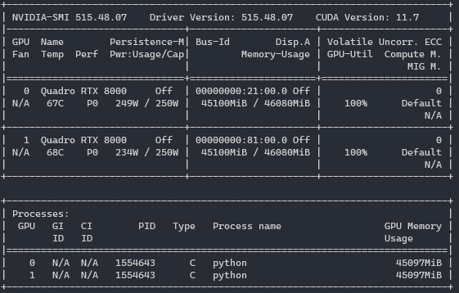
Nvidia-smi
Driver and CUDA versions
GPU Memory Usage in MB and %age total
Individual GPUs in the node
Processes currently running
Notes:
The first method we have for monitoring GPU usage is nvidia-smi
This is a tool from nvidia that shows a snapshot of whats happening in a GPUI enabled node

Slide 24
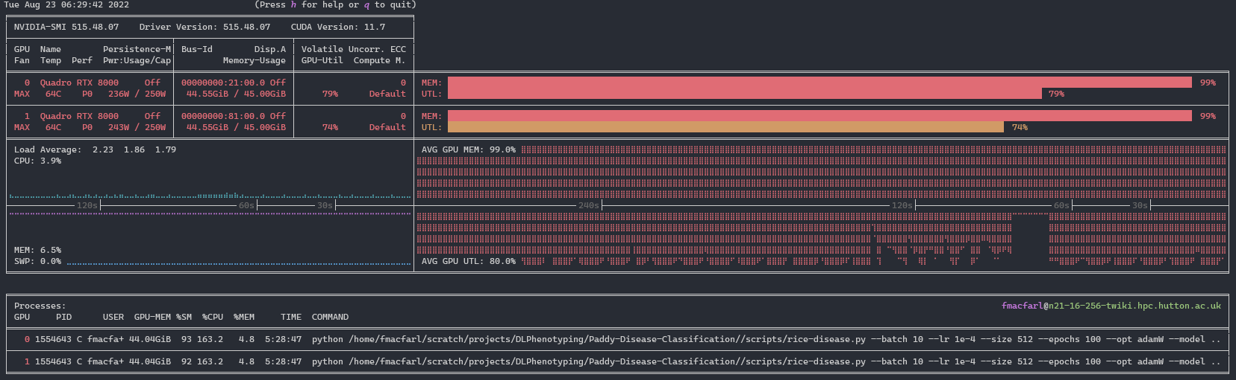
nvitop
Driver and CUDA versions
Ticker showing utilisations over the last few minutes
Graphical output of current memory usage and utilisation
Individual GPUs in the node
GPU Memory Usage in MB and %age total
Processes currently running
Similar outputs for CPU and RAM usages

Slide 25
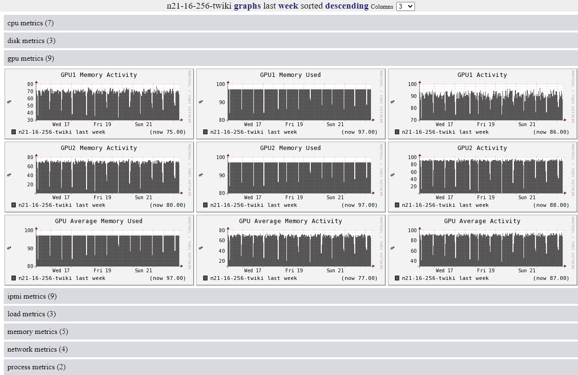
Ganglia
Memory Activity
Memory Used
GPU Core Activity

Slide 26

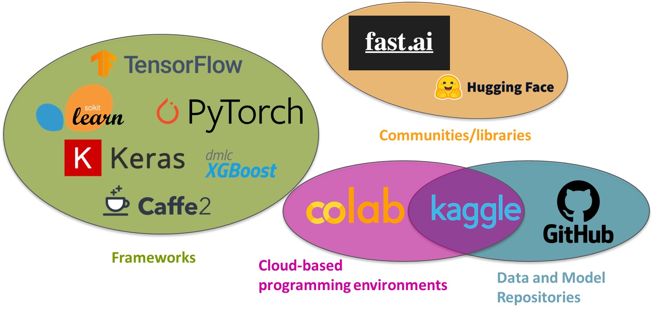










Machine Learning Frameworks + Materials
Communities/libraries
Frameworks
Cloud-based
programming environments
Data and Model Repositories

Slide 27
CUDA
Compute Unified Device Architecture
Parallel computing platform
Programming model and API
Written in/extension of C/C++
Enables GPUs more general purpose processing
Originally GPUs were intended for computer graphics and rendering
In essence – it turns our code into machine readable GPU code
Along with language specific frameworks, CUDA handles memory and resource allocation as well as all read/write operations

Slide 28
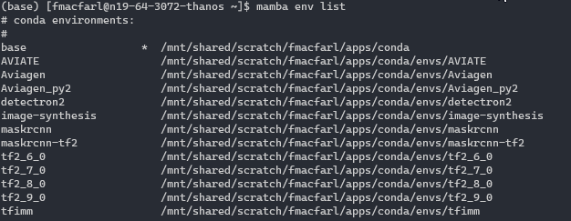
conda/mamba environments
Managing various tools and models/frameworks easily
TF vs Pytorch vs Caffe, TF2.7 vs TF2.8 both requiring various versions of numpy, scikit, pandas, open-cv etc.
Things common to all other envs go in base (mamba/jupyter) – works best if version agnostic

Slide 29
Where to start with Machine Learning?
Kaggle has some good beginner problems and a very active community (https://www.kaggle.com/competitions - filter for “Getting Started”)
Text, image, graph, etc. based problems
Titanic Passenger – Tabular dataset to predict passenger survivability on the RMS Titanic
Tensorflow project pages and inbuilt dataset catalogue (https://www.tensorflow.org/datasets/catalog)
Very over used and therefore highly understood
Two I recommend for Computer Vision:
MNIST – digit recognition
Fashion MNIST – Clothing
No courses are required but can be a very quick way to go deeper into the theory
Many are much more maths based
Frameworks like pytorch, scikit-learn and TensorFlow make it much more accessible

